Slide 1
Governance risk scorecard
Chosen questionnaire

Slide 2
4 categories
Category I: Rights and equitable treatment of shareholders (30%) : Monil
Category II: Role of stakeholders (10%) : Supriya
Category III: Transparency and Disclosure (30%) : Akash
Category IV: Responsibilities of the board (30%) : Divay

Slide 3
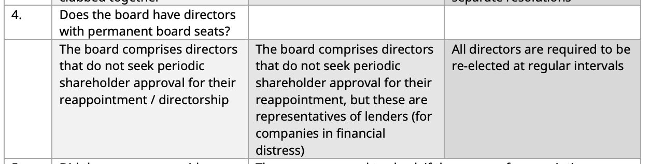
Category I: Rights and equitable treatment of shareholders
Board Permanency
See if the appointment date or reappointment date is within 5 years for all directors.
If a director is from lender group, find that out. (If explicitly mentioned)
Source : Link
Notes:
Some promoters have long believed that their right to run a company that they or their families founded is absolute. Several of these promoters have embedded themselves into the company permanently. There are two ways in which this is being done. First, by naming themselves into the Articles of Association or by appointing themselves as directors not liable to retire by rotation. Such directors, once appointed, do not need to seek periodic shareholder approval – they have board permanency.
SEBI too has recognized this and has modified regulations. From 1 April 2024, these directors will need to seek shareholder approval every five years to continue to serve on the board.

Slide 4
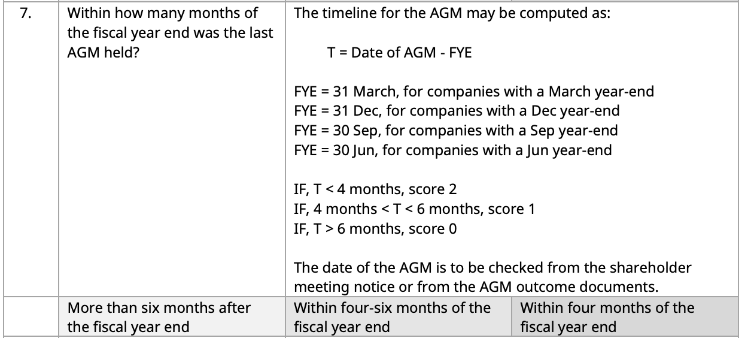
Category I: Rights and equitable treatment of shareholders

Slide 5
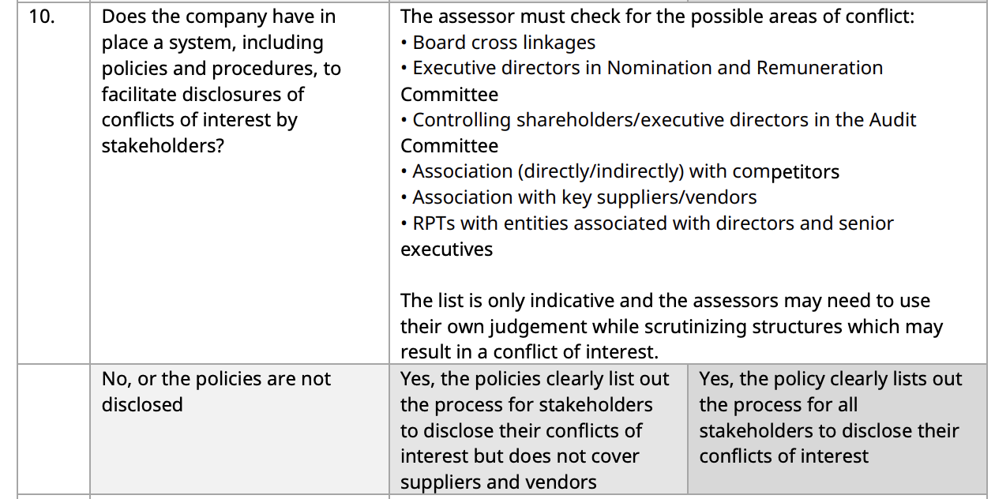
Category I: Rights and equitable treatment of shareholders

Slide 6
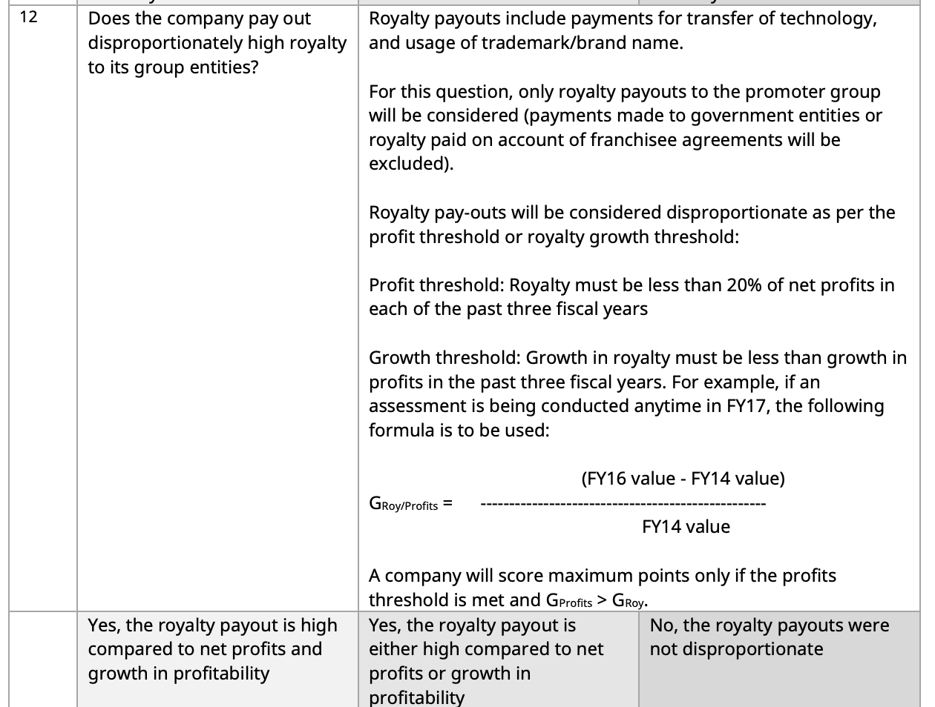
Category I: Rights and equitable treatment of shareholders

Slide 7
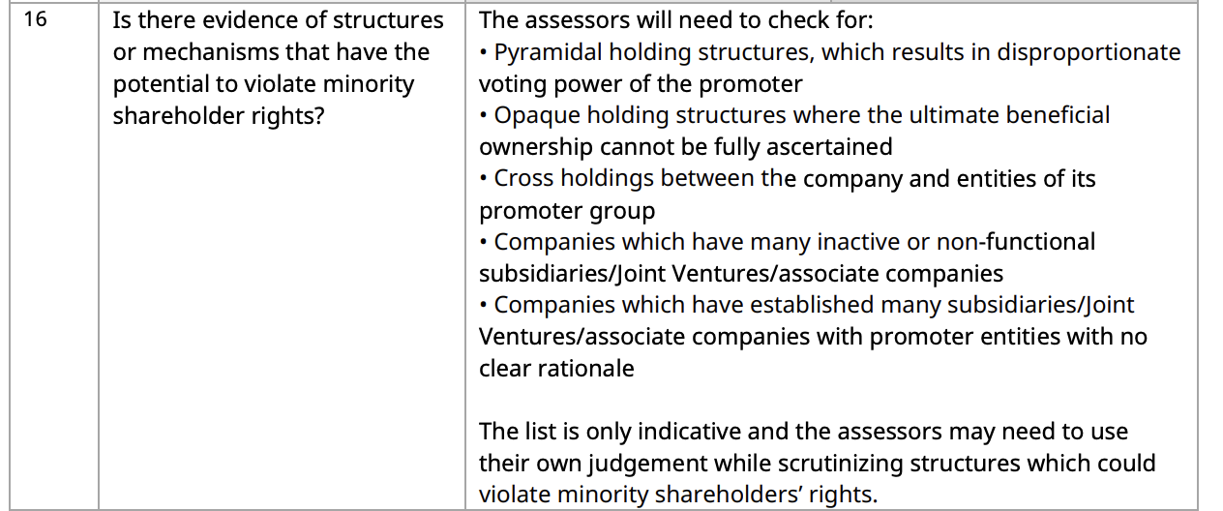
Category I: Rights and equitable treatment of shareholders

Slide 8
Category II: Role of stakeholders
Are following policies present: (Q17-Q20)
Prevention of occupation-related injuries, accidents and illnesses
stakeholder relationships
Sexual harassment : addressing reporting, redressal and inquiry
the company must report the number of employee accidents and sexual harassment cases each year to stakeholders – and the three-year trend should have a declining trajectory
policies for supplier/contractor management and selection.
CSR : check if 2% is spent and if where is it spent is disclosed
Whistle blower mechanism/policy
Any late repayment ? (Q21)
Check auditor’s notes and notes to annual financial statements for last 3 years

Slide 9
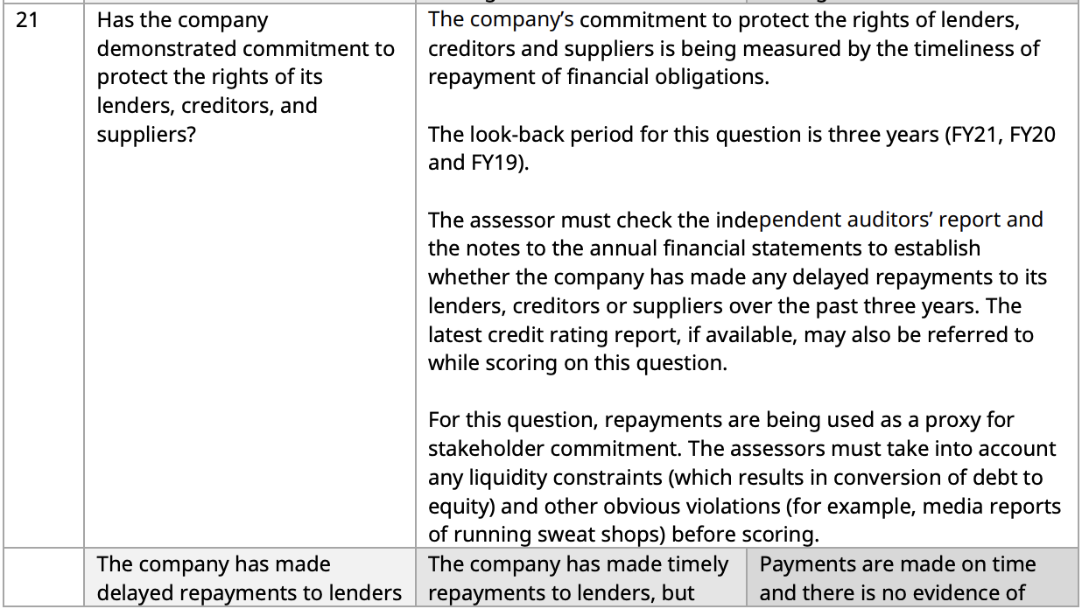
Category II: Role of stakeholders
Any late repayment ? (Q21)
Check auditor’s notes and notes to annual financial statements for last 3 years

Slide 10
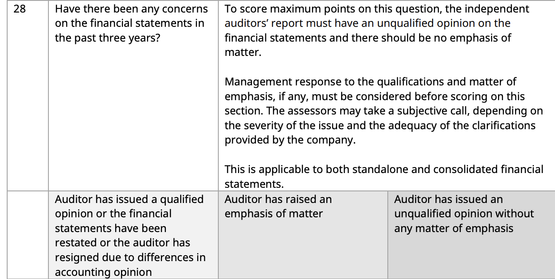
Category III: Transparency and Disclosure
Concerns over financial statements (Q28)
Check the independent auditors’ note: if qualified/unqualified/emphasis of matter is raised.

Slide 11
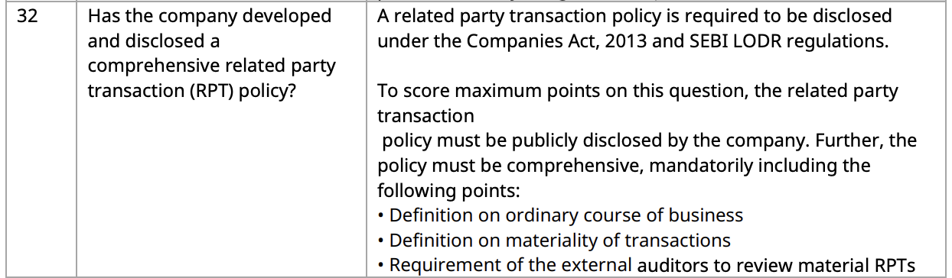
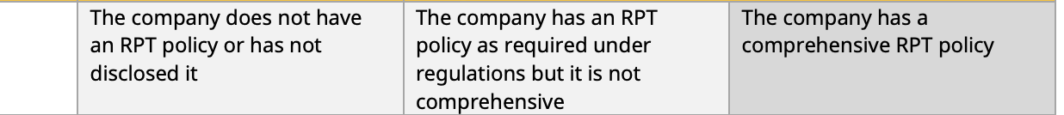
Category III: Transparency and Disclosure
Related Party Transactions (Q32)
Presence of the policy

Slide 12
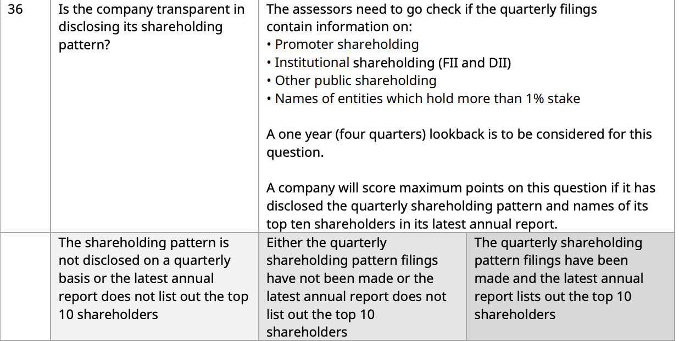
Category III: Transparency and Disclosure
Share holding pattern in quarterly results (Q36)
1 year lookback : promoter, DII,FII

Slide 13
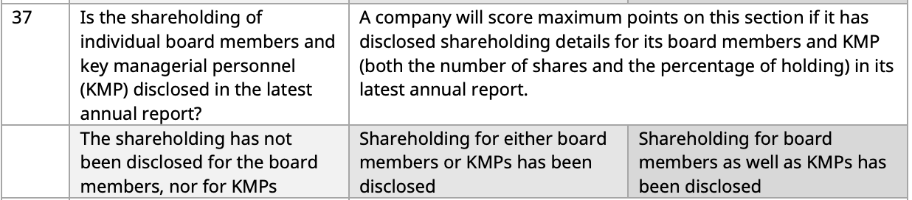
Category III: Transparency and Disclosure
Is the shareholding of individual board members and key managerial personnel (KMP) disclosed in the latest annual report? (Q37)

Slide 14
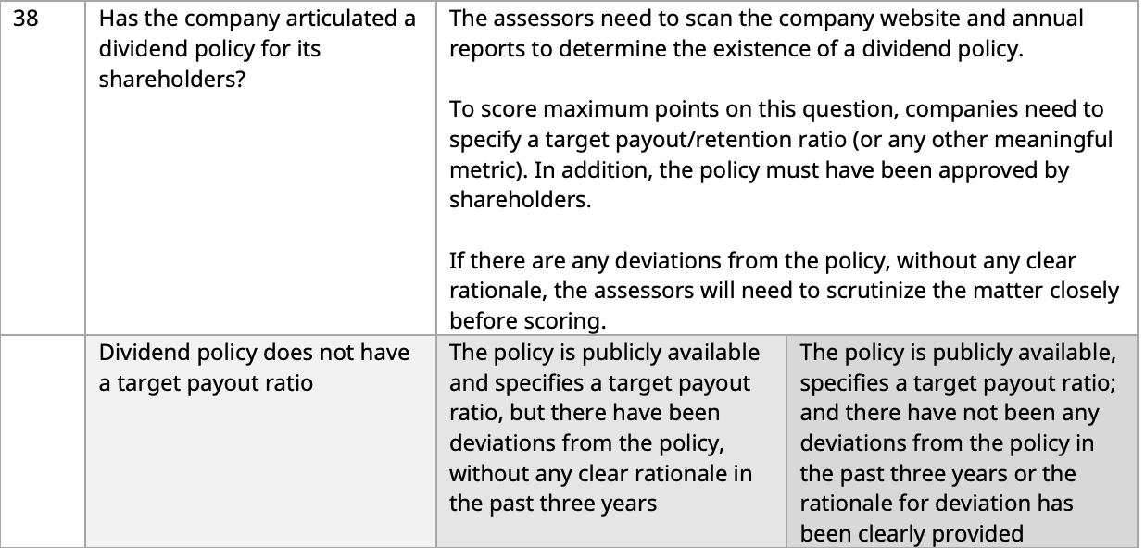
Category III: Transparency and Disclosure
Dividend distribution policy (Q38)
companies need to specify a target payout/retention ratio

Slide 15
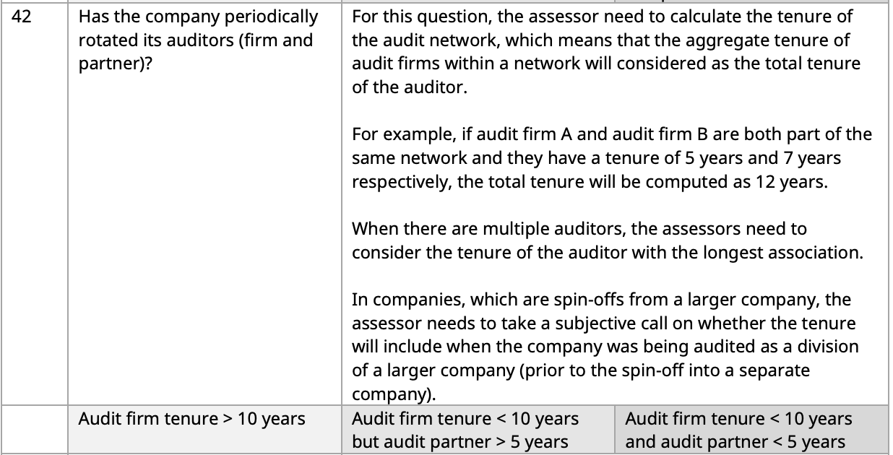
Category III: Transparency and Disclosure
Has the company periodically rotated its auditors (firm and partner)? (Q42)

Slide 16
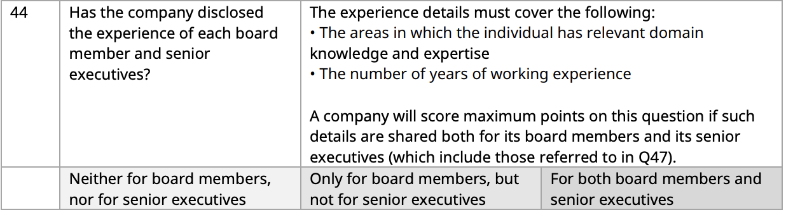
Category III: Transparency and Disclosure
Has the company disclosed the experience of each board member and senior executives? (Q44)

Slide 17
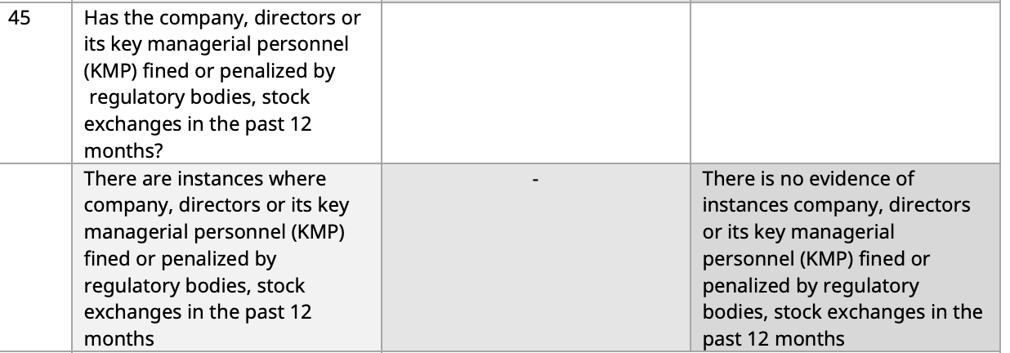
Category III: Transparency and Disclosure
Has the company, directors or its key managerial personnel (KMP) fined or penalized by regulatory bodies, stock exchanges in the past 12 months? (Q45)

Slide 18
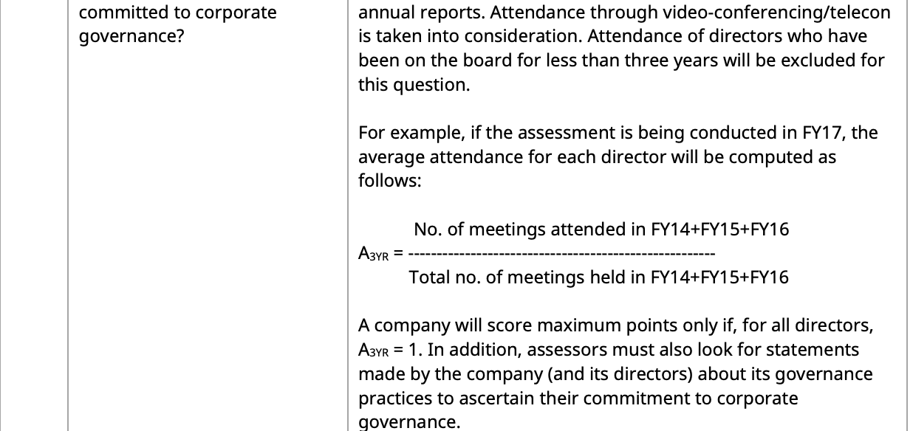
Category IV: Responsibilities of the board
Engagement of directors (Q48)

Slide 19
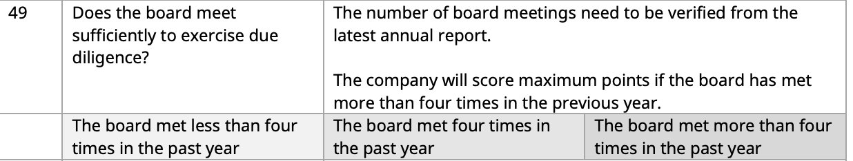
Category IV: Responsibilities of the board
Does the board meet sufficiently to exercise due diligence? (Q49)

Slide 20

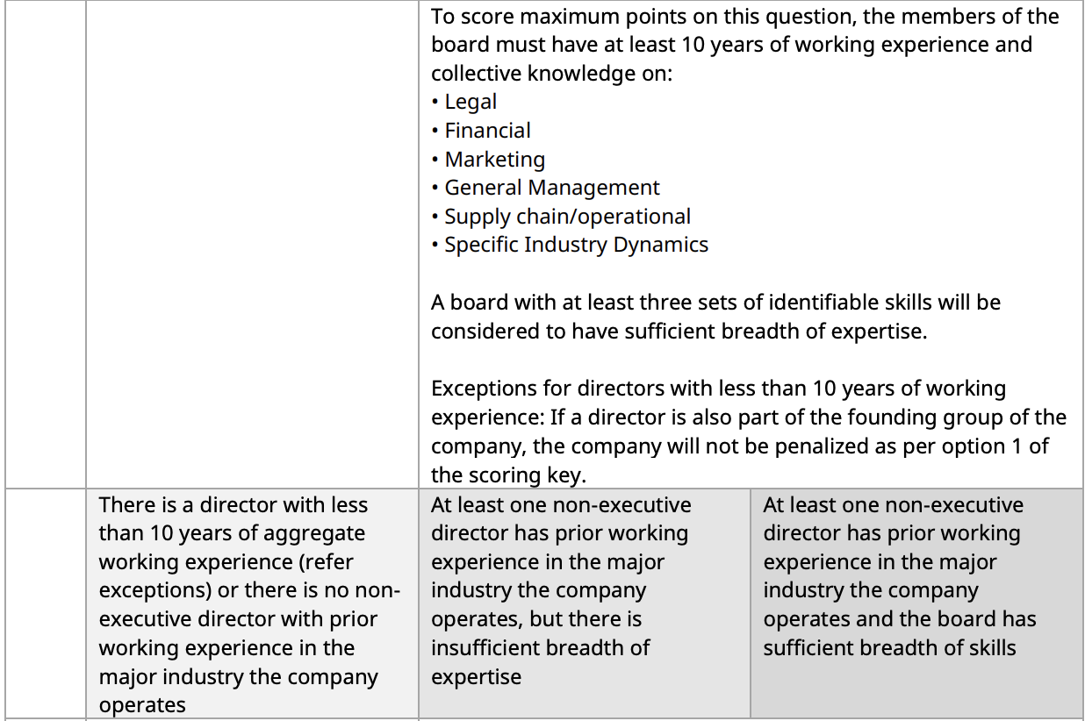
Category IV: Responsibilities of the board
Board competence (Q51)
Wide spectrum of expertise with at least 10 years of experience

Slide 21
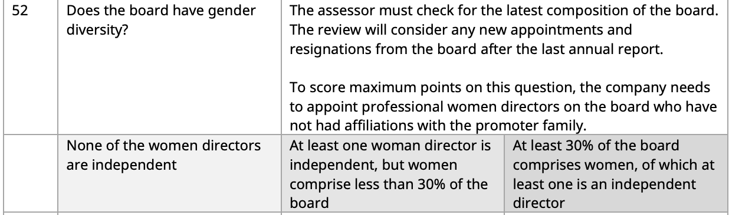
Category IV: Responsibilities of the board
Gender diversity on board (Q52)
The company needs to appoint professional women directors on the board who have not had affiliations with the promoter family.

Slide 22
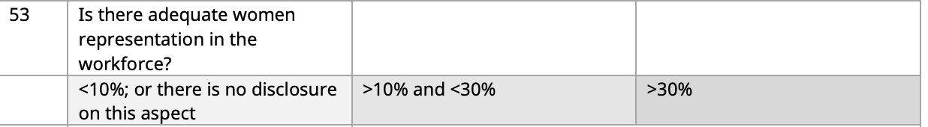
Category IV: Responsibilities of the board
Is there adequate women representation in the workforce? (Q53)

Slide 23
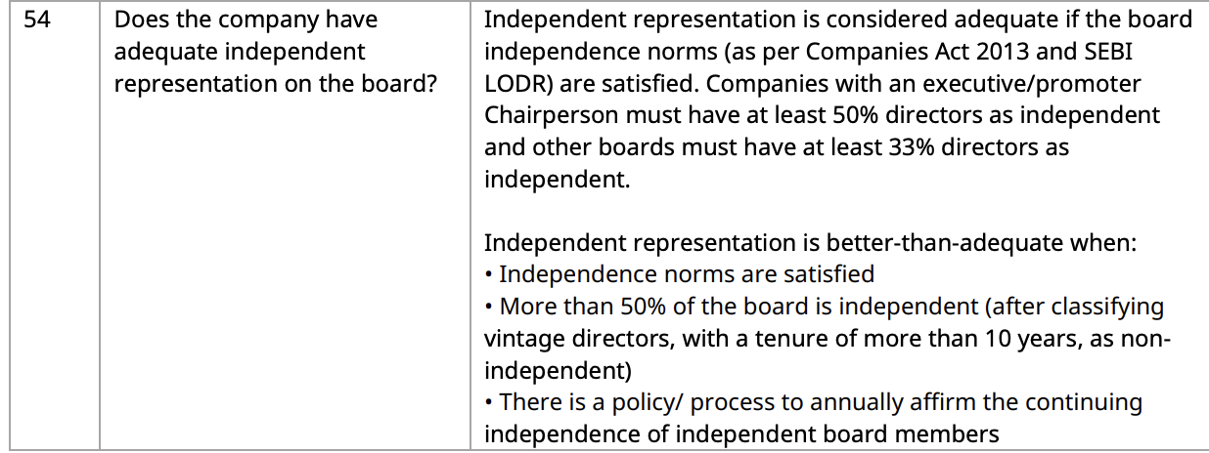
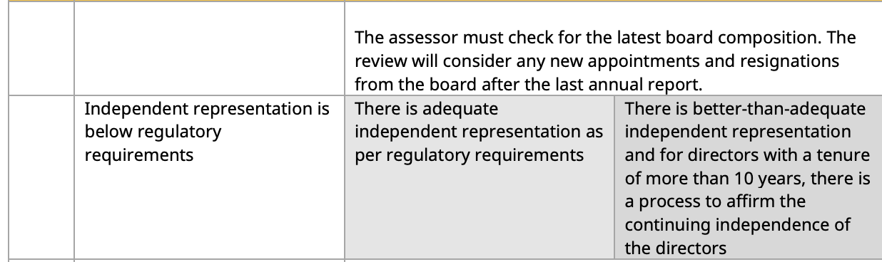
Category IV: Responsibilities of the board
Adequate independence of the board: (Q54)
Companies with an executive/promoter Chairperson must have at least 50% directors as independent and other boards must have at least 33% directors as independent

Slide 24
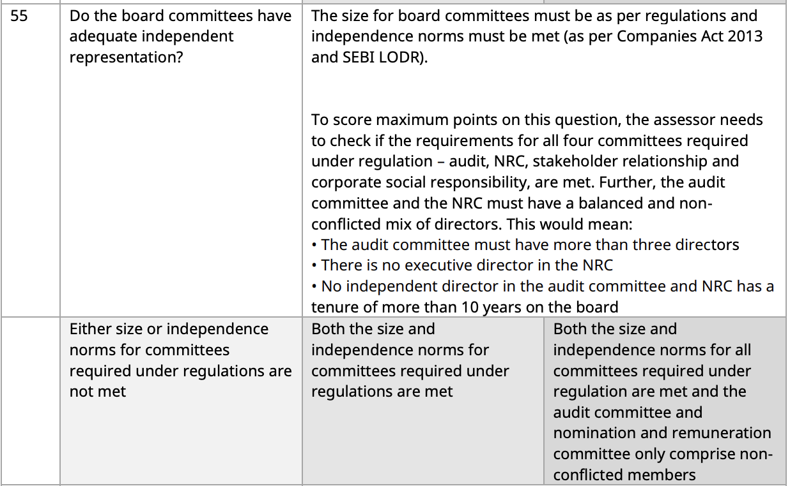
Category IV: Responsibilities of the board
Do the board committees have adequate independent representation? (Q55)
The audit committee must have more than three directors • There is no executive director in the NRC • No independent director in the audit committee and NRC has a tenure of more than 10 years on the board

Slide 25
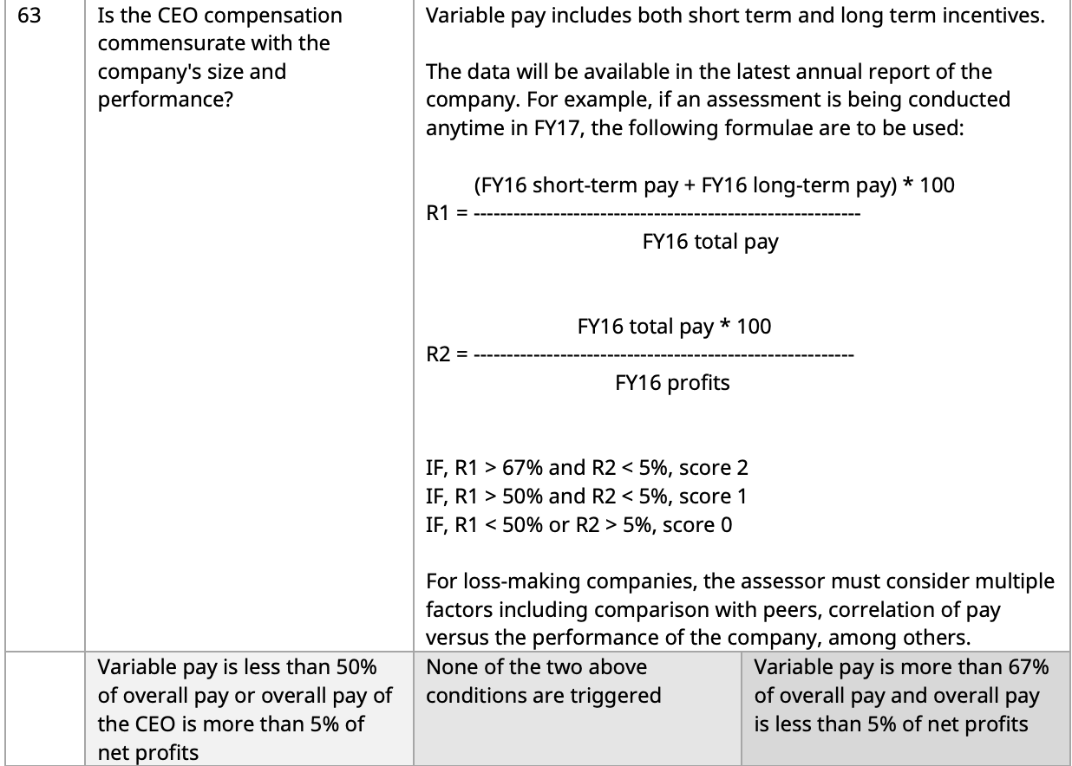
Category IV: Responsibilities of the board
CEO compensation commensurate with the company's size and performance? (Q63)

Slide 26
Sources needed
Annual Report
Exchange websites
Company website
Screener
Web search

